Slide 1
Gene Regulation
Tim Reddy
Genomic Public Resource Workshop
October 3, 2023

Slide 2
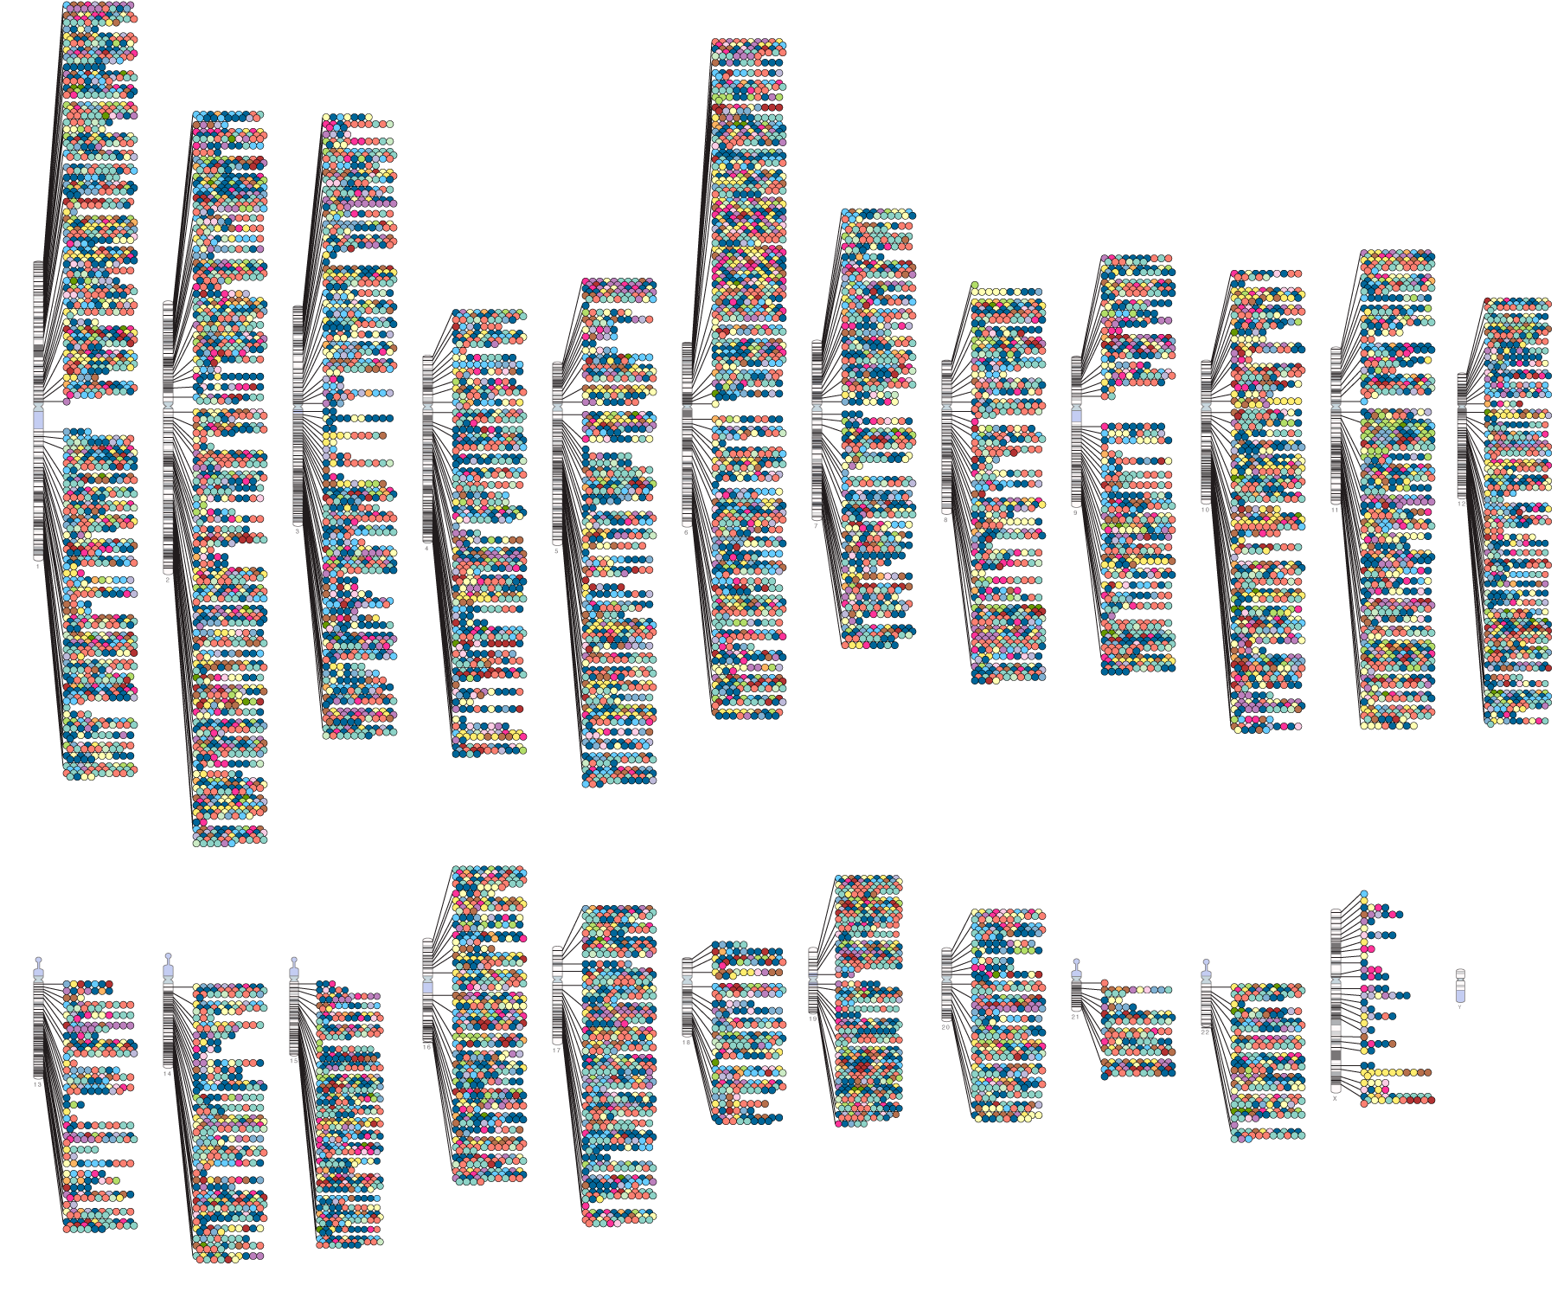
Catalog of genetic associations
NHGRI-EBI GWAS Catalog
Notes:
Almost all of the variants are intergenic. We haven’t come up with much.

Slide 3
Genetic associations with common diseases are largely non-coding
Protein Coding
(7%)
Untranslated Exonic
(2%)
Non-coding
(91%)

Slide 4
What are the functions of the non-coding genome and how does genetic variation alter that function and contribute to disease?

Slide 5
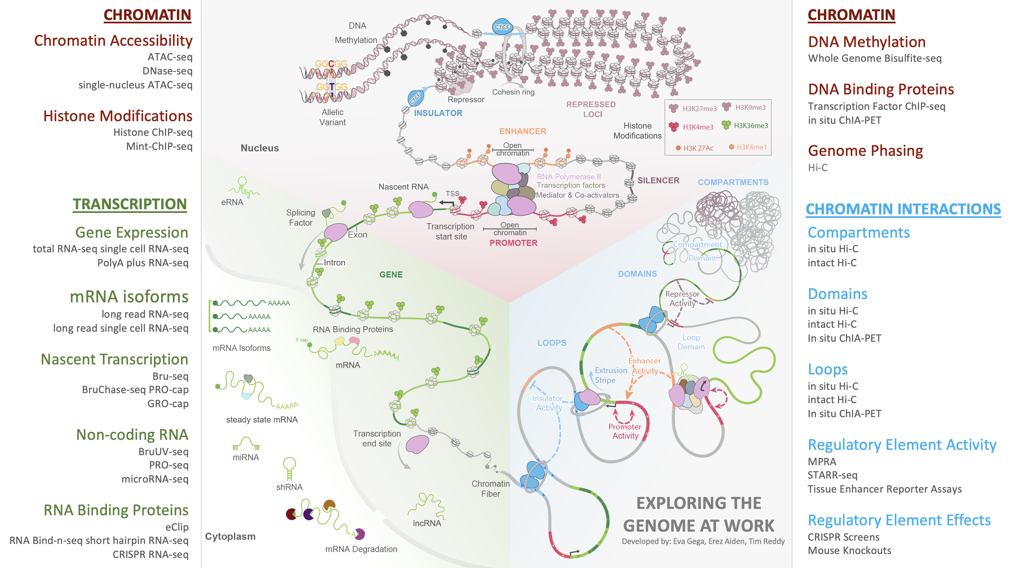

Slide 8
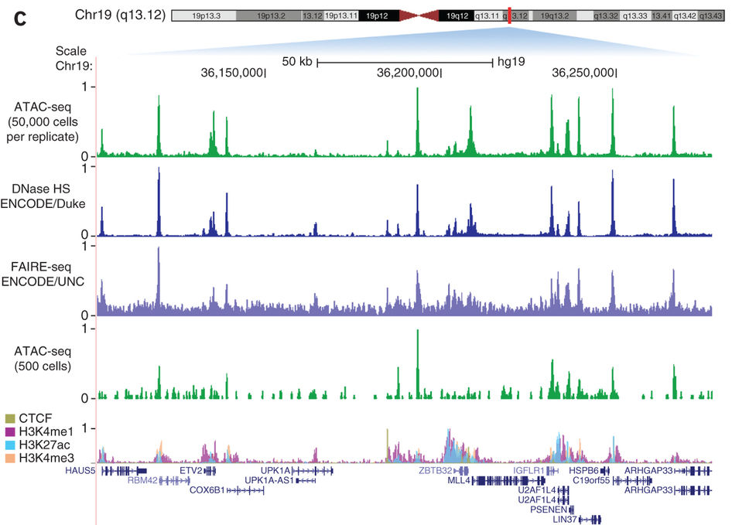
Mapping open chromatin with ATAC-seq and DNase-seq
Buenrostro JD et al, Nature Methods, 2013

Slide 10
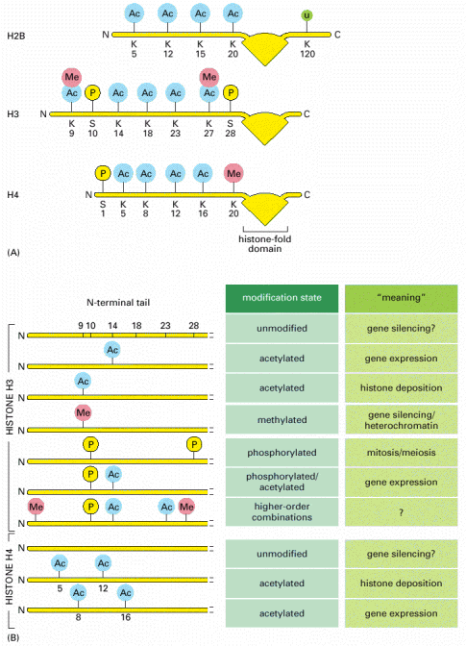
The histone code
Histone Acetylation
Typically activated gene expression
Histone Methylation
Depends on residue
Activated gene expression (K4)
or Repressed gene expression (K9)
mono, di, and tri methylation
H3K4me1=enhancers
H3K4me3=promoters
Histone H3

Slide 11
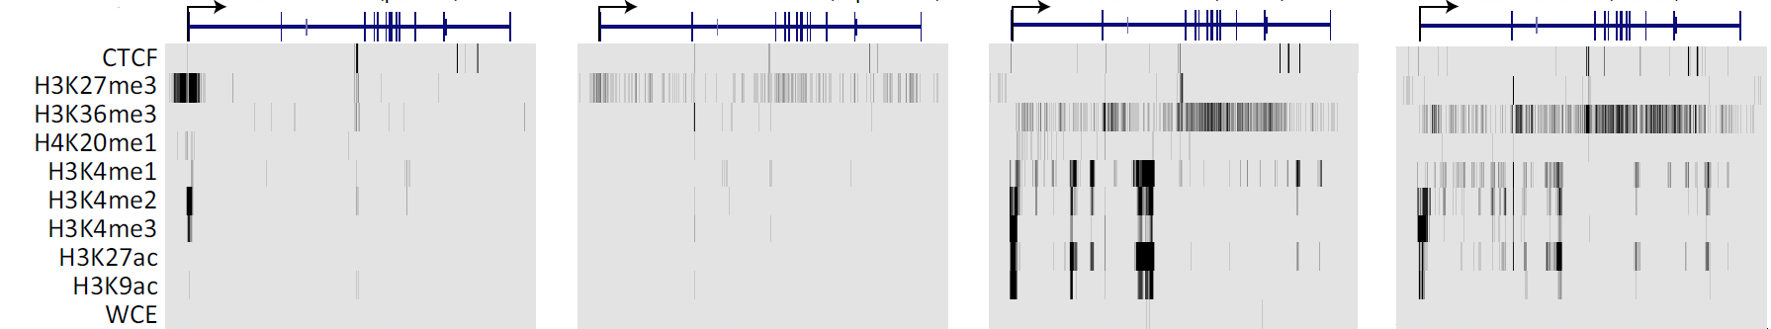
ChIP-seq across cell types shows different histone marks near wntless
Stem cell
B cell
endothelial
fibroblast
WLS gene
WLS gene
WLS gene
WLS gene
Repressed
Silent
Active
Active
Notes:
Key points to make:
Chromatin states enabled us to study the dynamic nature of chromatin across many cell types.
By distinguishing 15 different types of chromatin states, we could summarize all significant combinations of 81 different chromatin tracks and 2.4 billion reads in just nine chromatin annotation tracks, one for each cell type.
For example, the same gene (WLS), is ‘poised’ in embryonic stem cells (ES), repressed in three other cell types (K562, blood, and liver), and active in the other five cell types.
This allows us to now define ‘vectors’ of activity for each region of the genome, based on the chromatin annotation in the nine cell types.

Slide 16
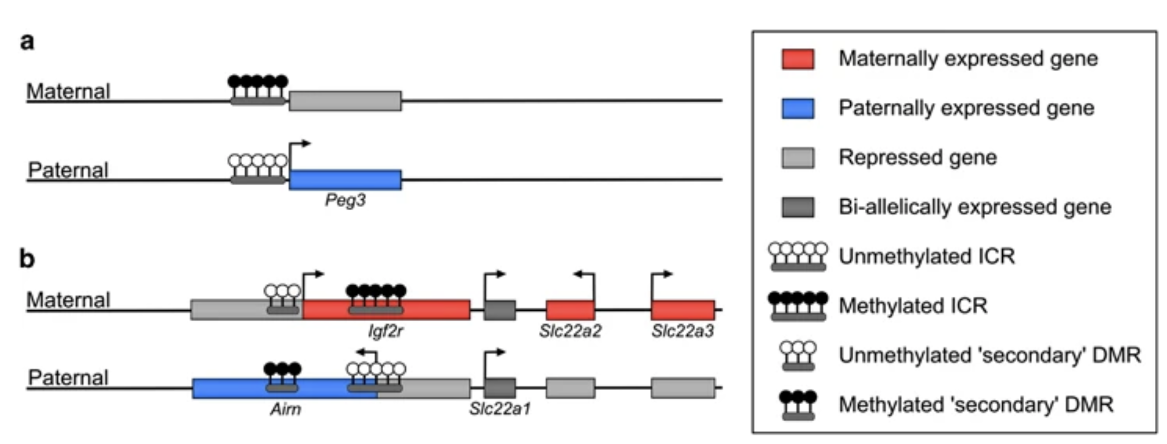
Imprinting: expression of a gene from one parent

Slide 17
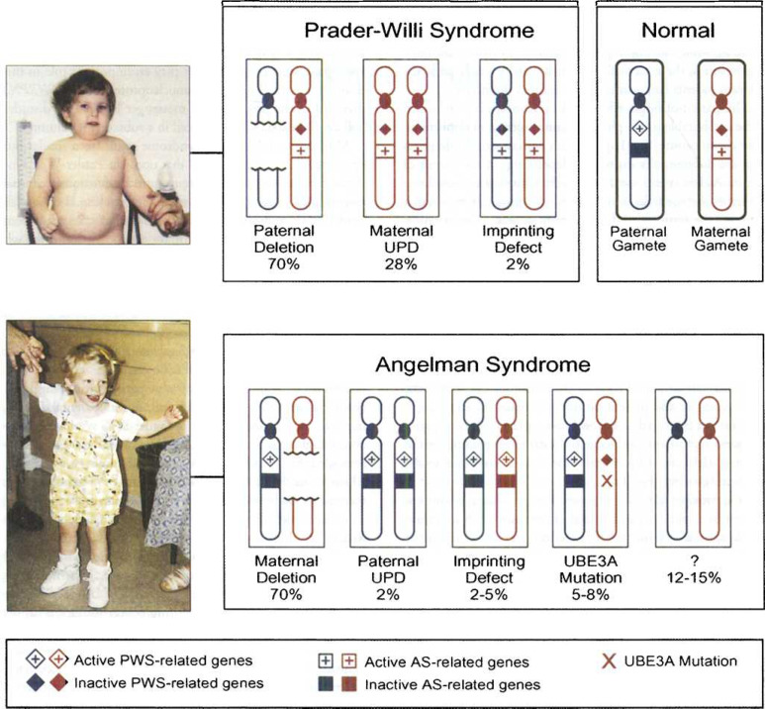
Disorders due to dysfunction at imprinting loci

Slide 18
The ENCODE Encyclopedia

Slide 19
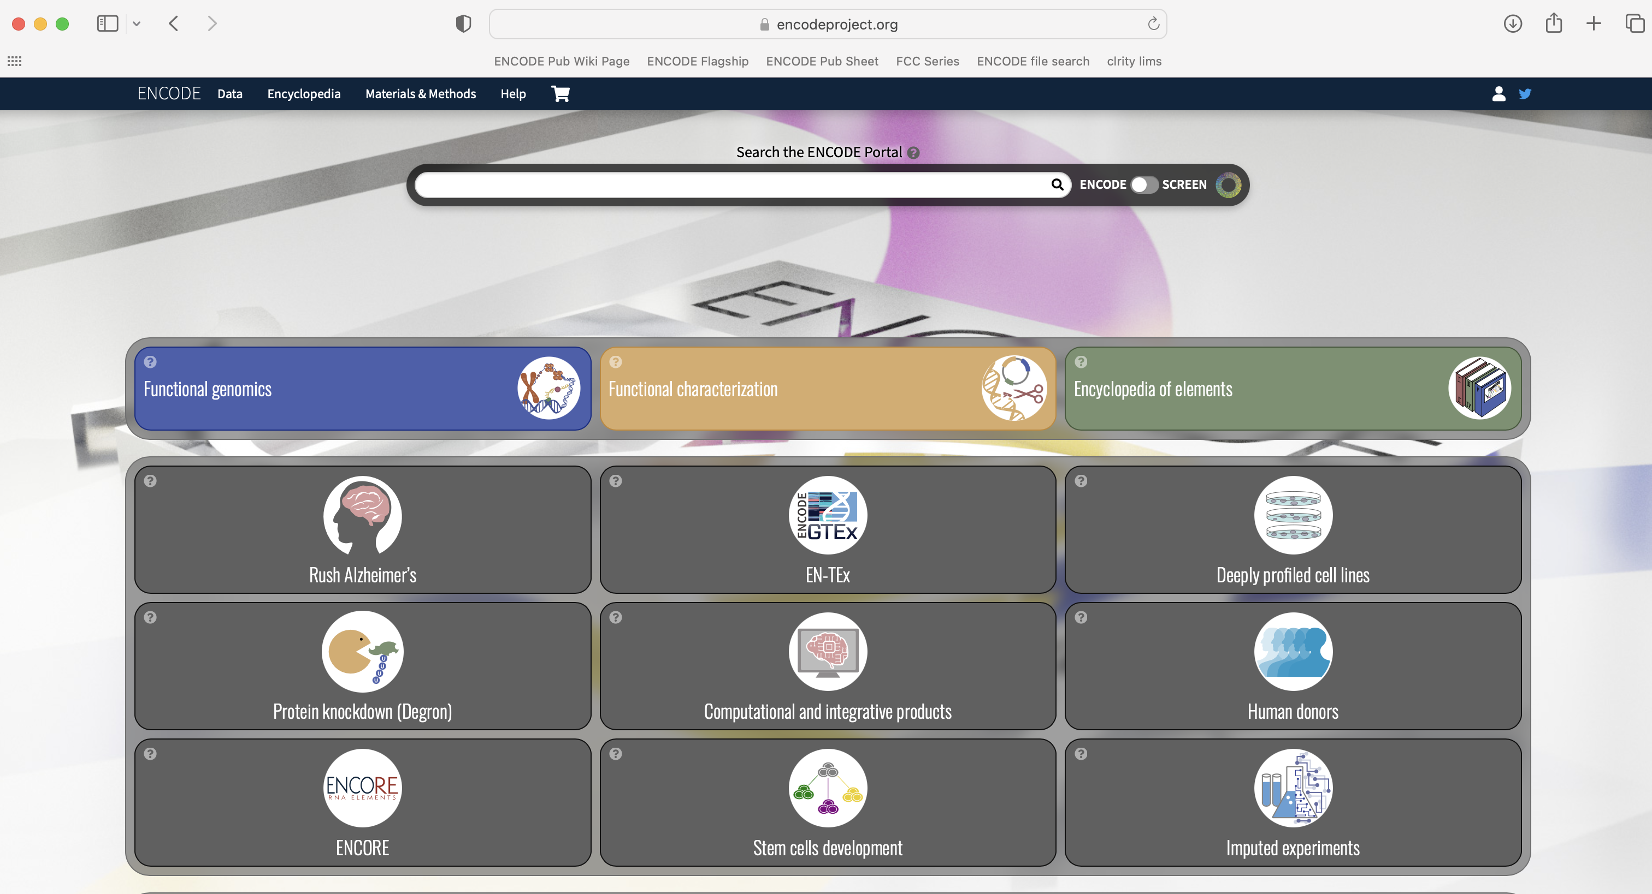
encodeproject.org

Slide 20
encodeproject.org

Slide 21
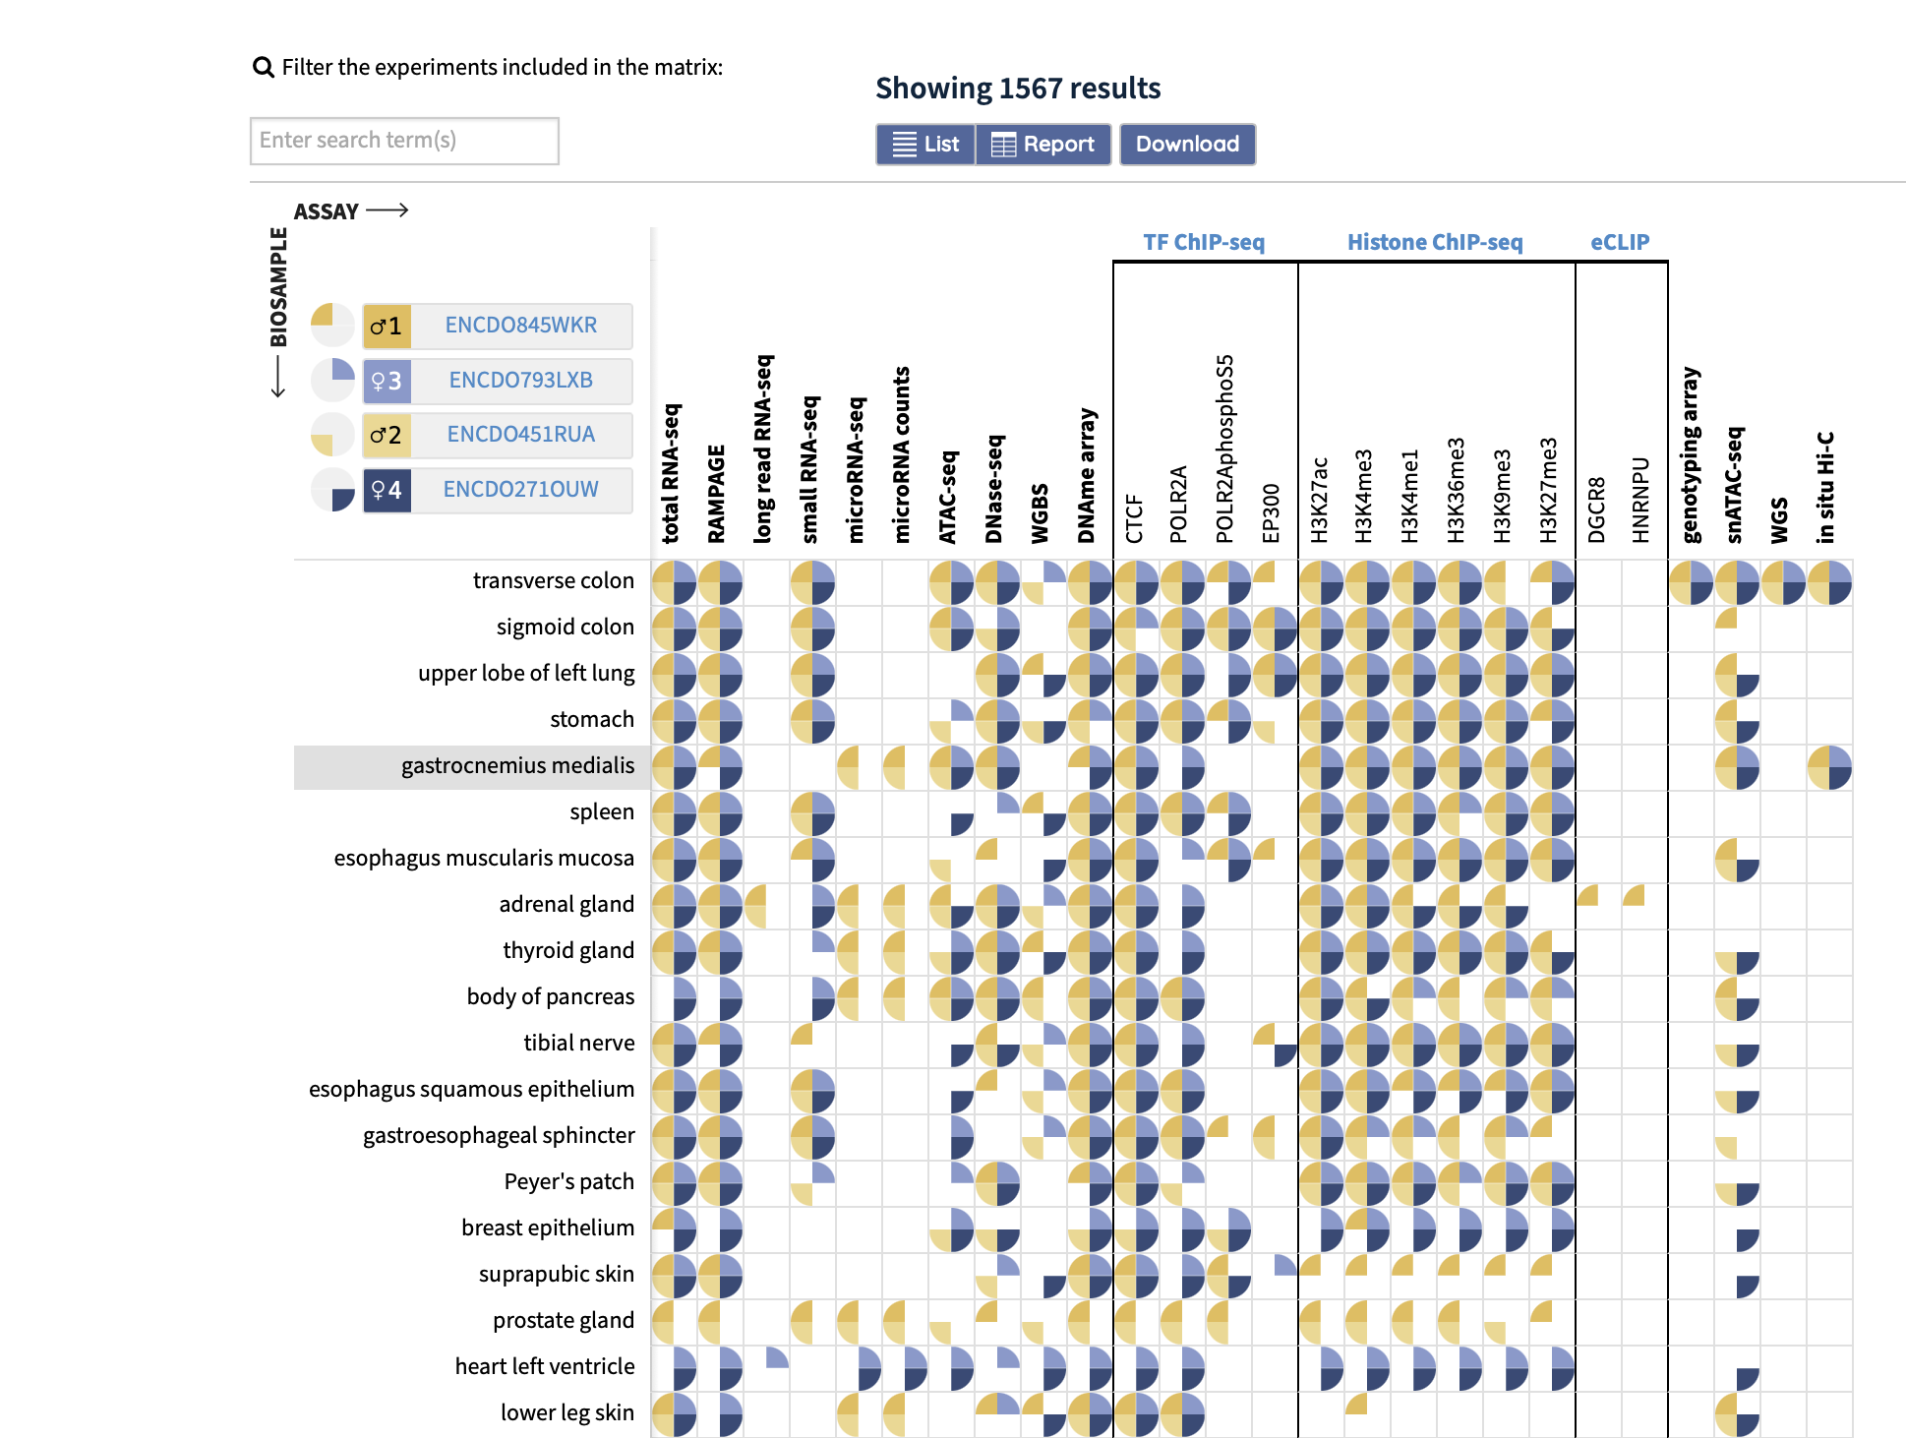
encodeproject.org

Slide 22
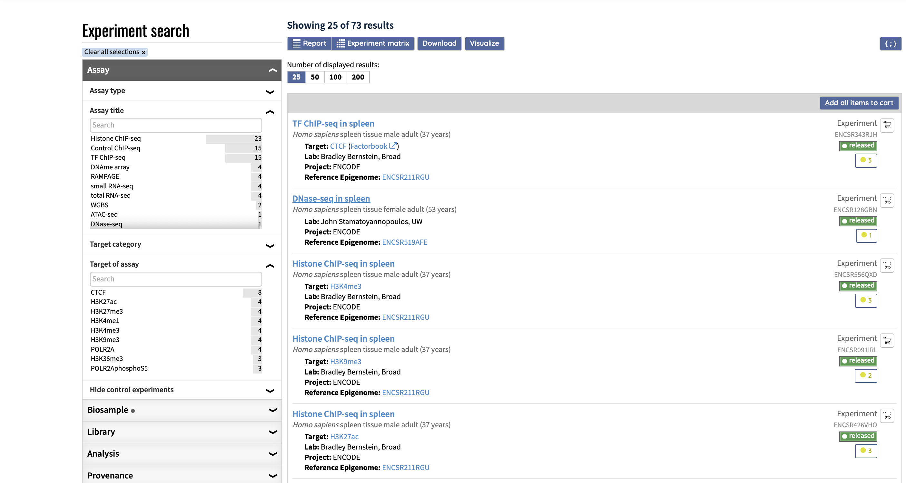
encodeproject.org

Slide 23
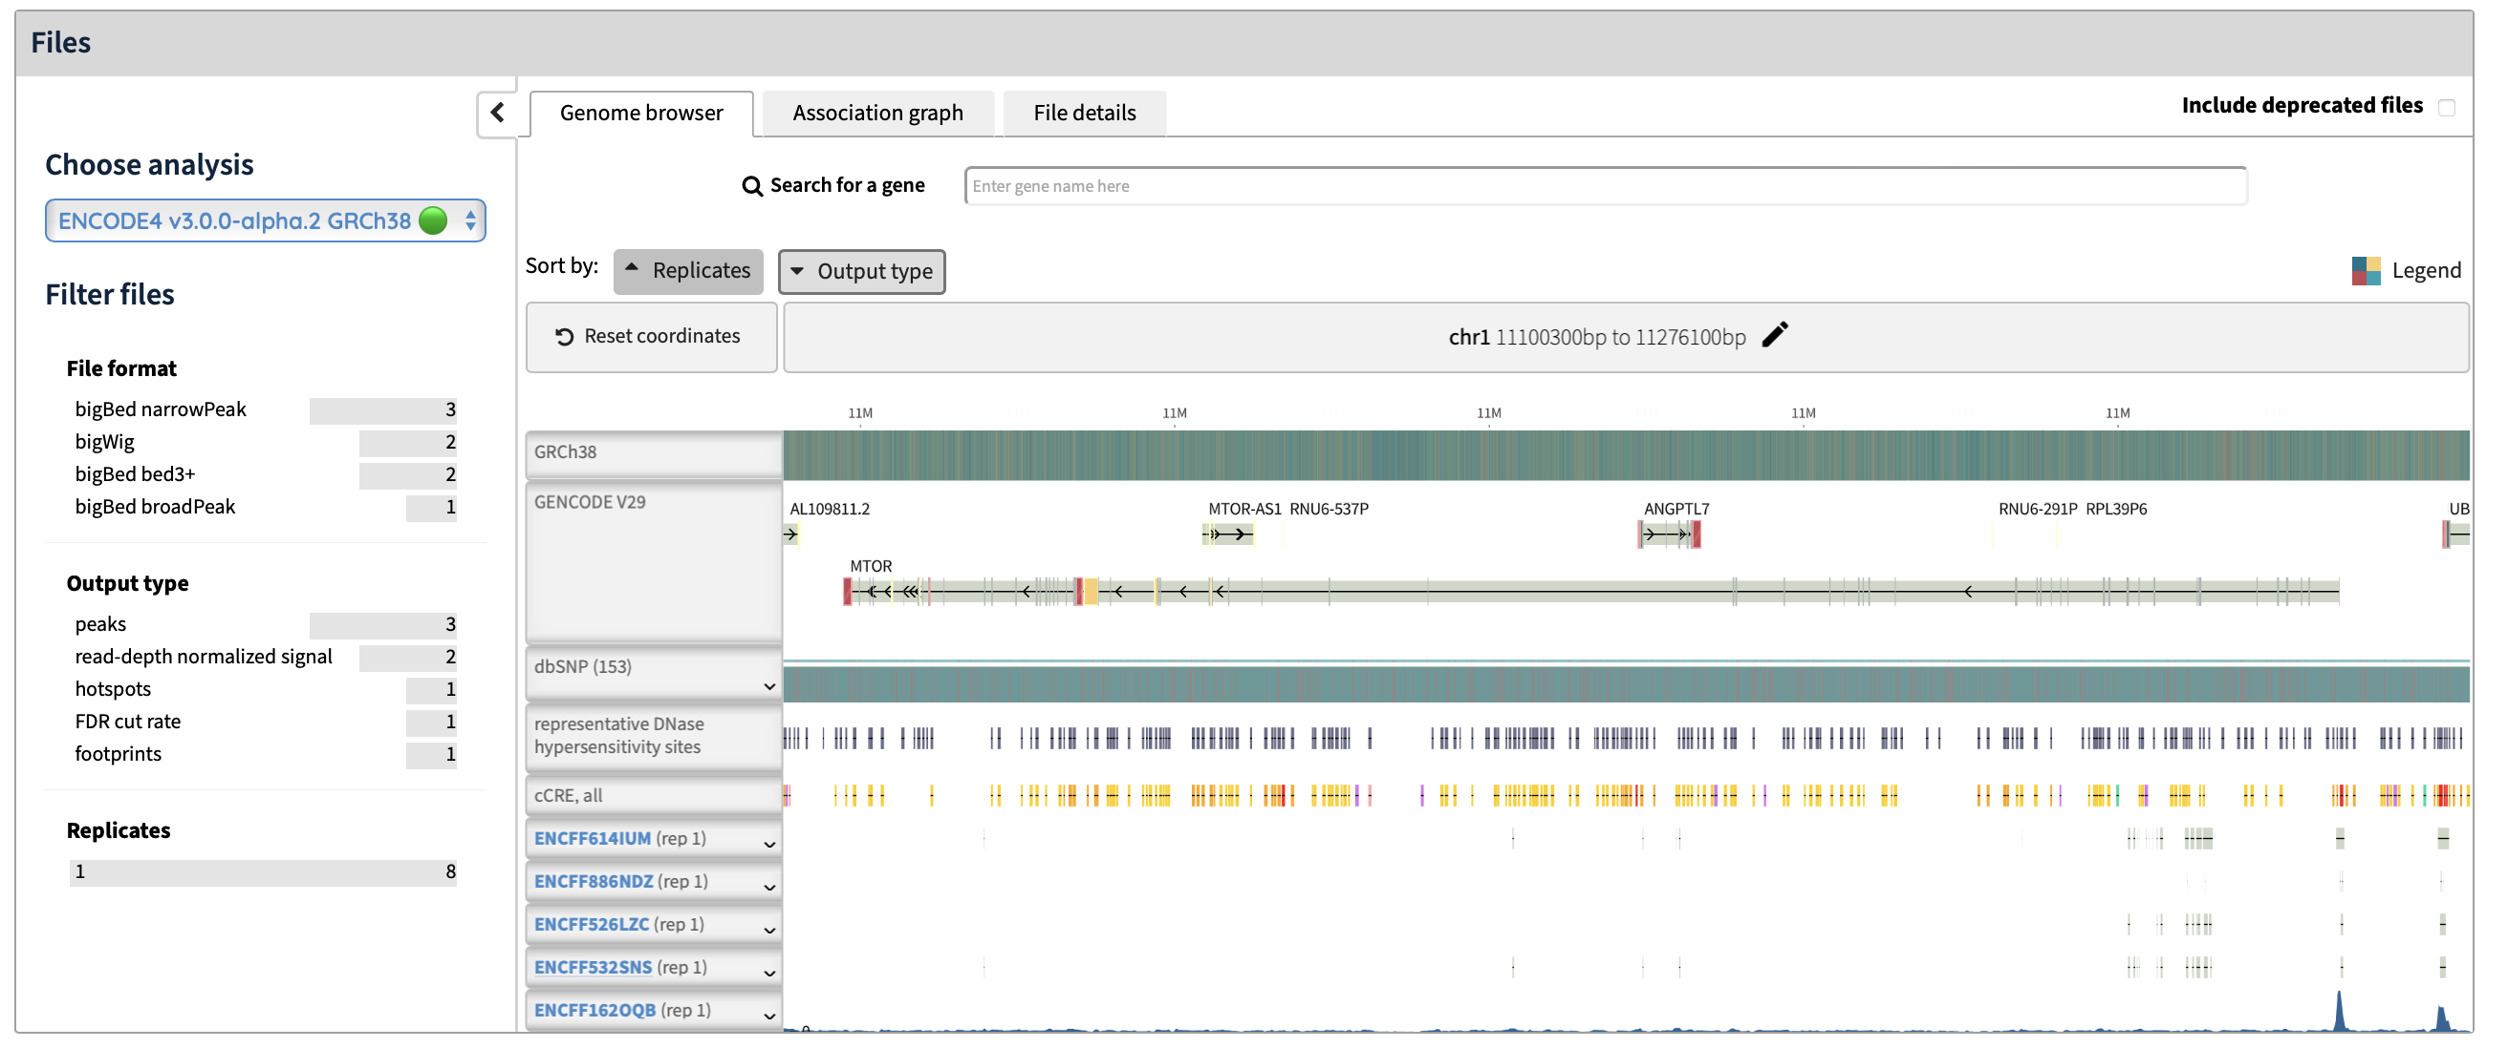
encodeproject.org

Slide 24
Summary
A substantial fraction of phenotypic variation involves noncoding genetic variation
Many features of the noncoding genome contribute to gene regulation including chromatin accessibility, histone modification, and DNA methylation
The ENCODE project is a major resource for gene regulatory features in diverse human and mouse tissues

